Slide 1
Colorado Population Growth
Rob Kemp
State Demography Office
Colorado Department of Local Affairs
December 2015

Slide 2
Colorado’s Population Landscape

Slide 3
Big Picture - 2013-2014 Pop Change
US – 318 million, + 2.3 million or 0.7%
Colorado- 5,353,471
4th fastest growth at 1.6%
8th largest absolute change adding 83,700
Growth Varies Across the State
Notes:
Ranked 4th fastest 1.6% - ND, NV, TX
8th absolute growth 83,700 – TX, CA, FL, GA, AZ, NC, WA

Slide 4
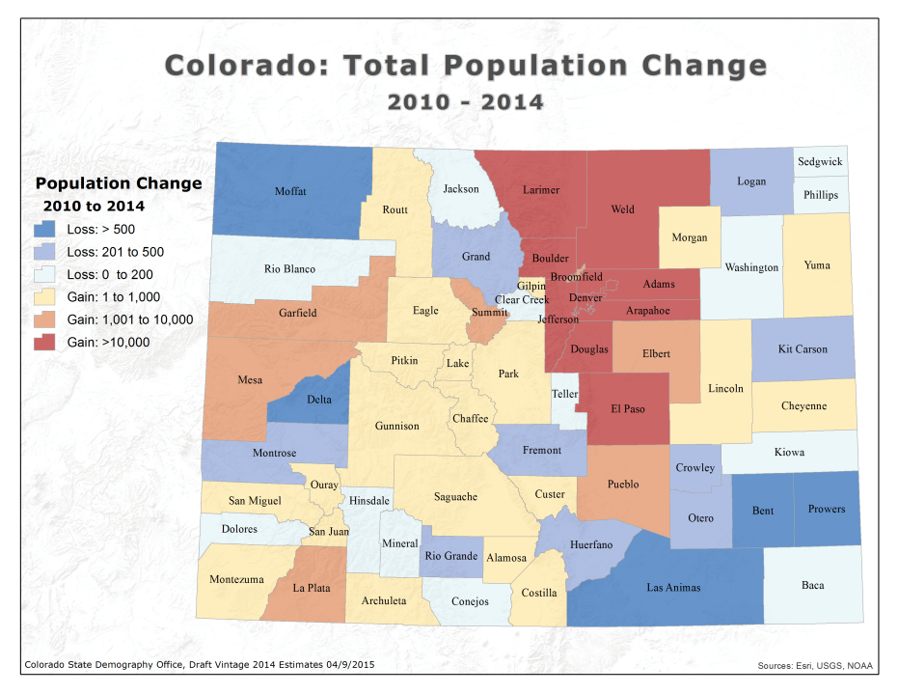

Slide 5
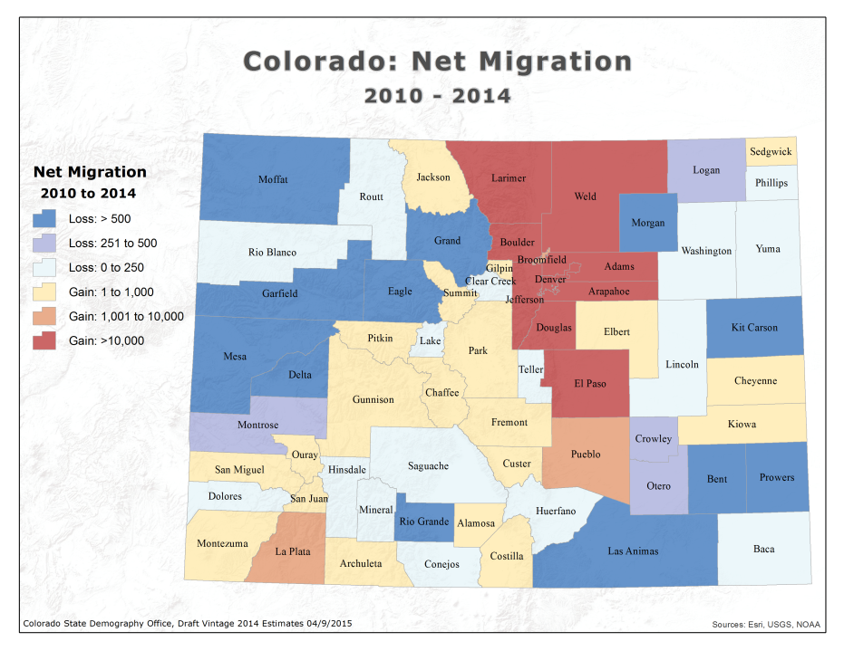
Notes:
34 counties with out migration
Bent, Crowley and Fremont had declines in prison population

Slide 7
Population Growth

Slide 8
Population Growth
Year | Population | Percent Change from 2015 | Average Annual Percent Change
2020 | 5,935,920 | 9.0% | 1.8%
2025 | 6,454,860 | 18.6% | 1.7%
2030 | 6,970,651 | 28.1% | 1.7%
Projected 2015 Population: 5,443,612
Source: State Demography Office 2015 Projections
Notes:
Population growth of 28% by 2030
Annual Average: 1.6% per year
Based on traditional population projection model
Includes linkages to an economic model to help understand economic migration.

Slide 9
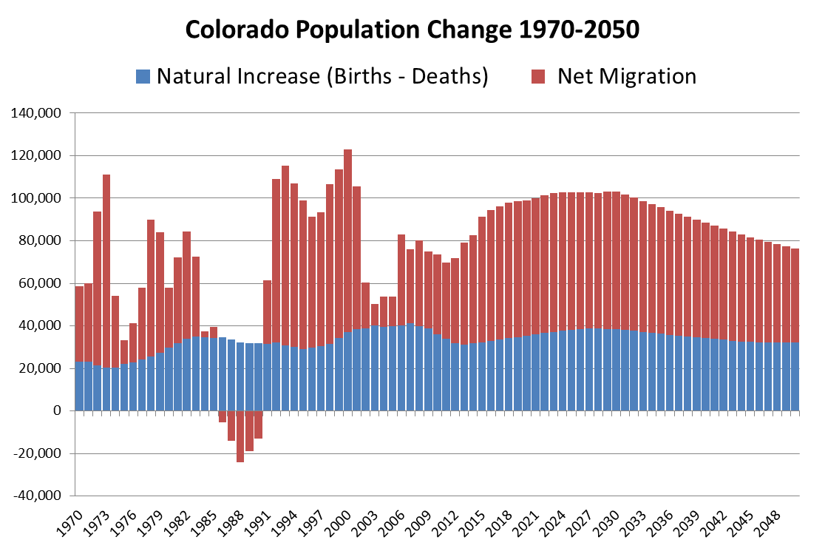

Slide 10
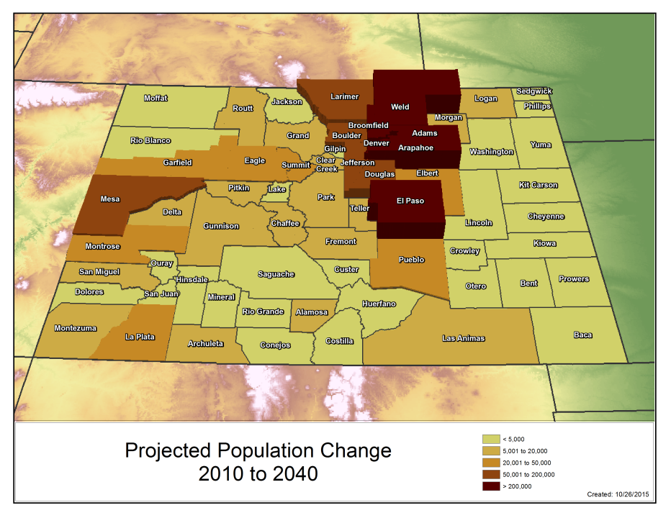
Notes:
FR 82% of states population….remain 82% throughout forecast.
2040- 7.924
Change from 2010-2040
State – 2.8 mill
Front Range – 2.4 mil
Denver Metro – 1.4
NFR - 534K
SFR - 390K
WS - 342K
CM - 61K
SLV - 11K
EP - 64K
Non Front Range - 470

Slide 11
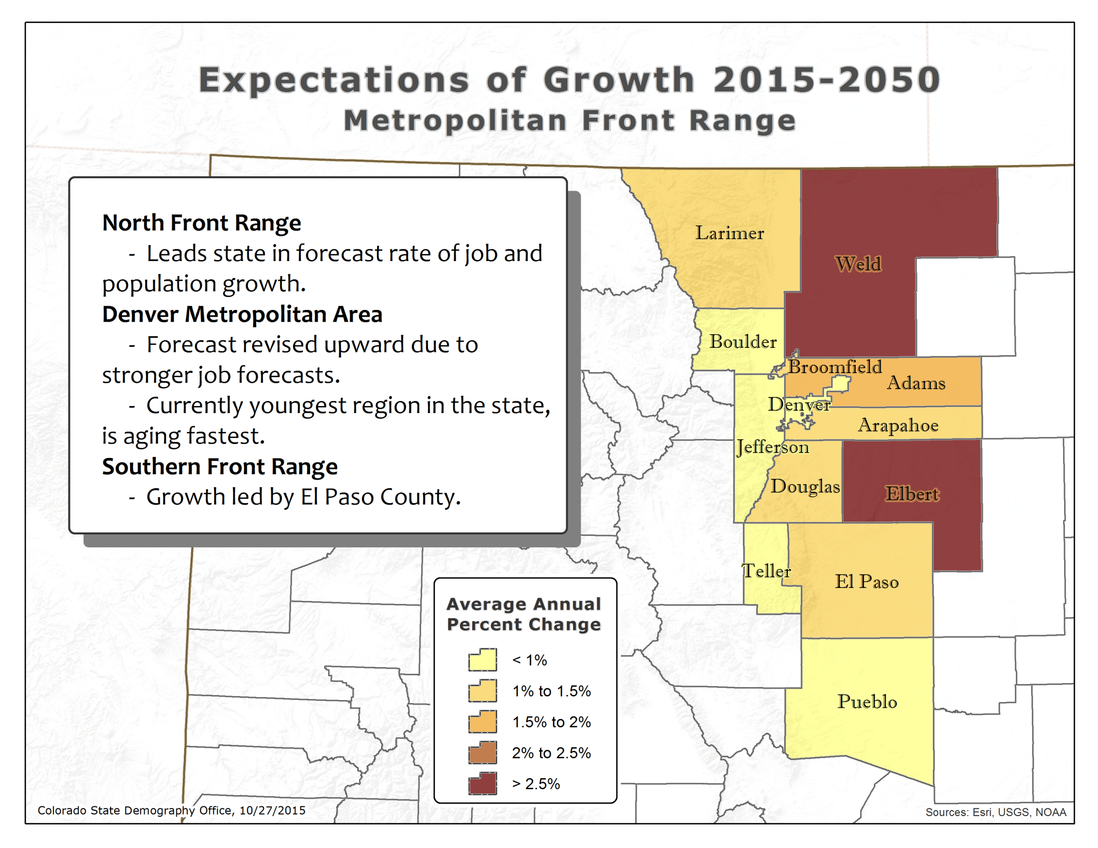

Slide 12
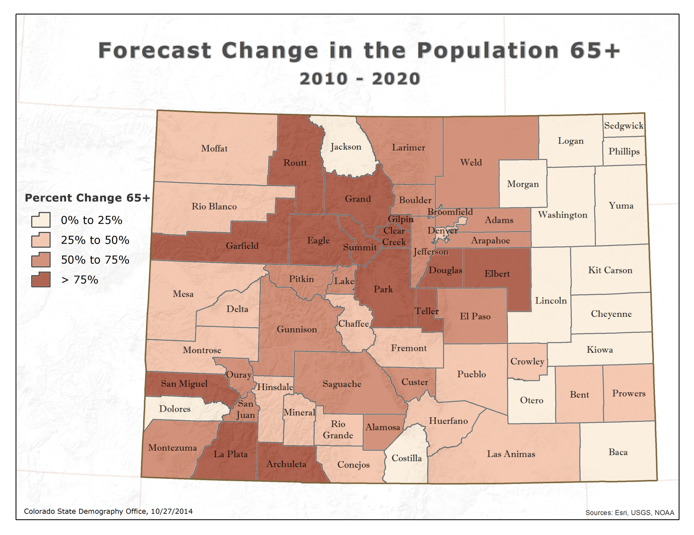
Map 65+ change
Notes:
Growing at >100%
Eagle
Elbert
San Miguel
Gilpin
Park
Grand
Summit
Douglas

Slide 13
Uncertainty
Most state & local population projections have a Mean Average Percent Error (MAPE) of 6-7% for 10 year projections and 11-15% for 20 years¹.
Demography Office MAPES
10 Year (1991-2005): 5.2%
20 Year (1988, 92, 93, 95): 14.3%
Migration most uncertain component.
¹"State and Local Population Projections" Smith, Tayman, and Swanson.
Notes:
Dampening Forces: Housing Prices
Bolstering Forces: Broadband outside Front R
Survival rates
Mortality levels most certain part of the model. Relatively little variations by region or over time.
Fertility
Very accurate, however, more variation by region.
Migration
Job forecasts, relative growth by region, and labor force participation rates are all subject to error.
Consistent and within the context of national forecasts, expert review.
ange

Slide 14
Household Growth

Slide 15
Household Growth
Households grow by 31% (1.9% per year) in next 15 years
2015: 2,173,941
2030: 2,868,387
Household size goes from 2.45 to 2.38
Most growth in over 65 year old households.

Slide 16
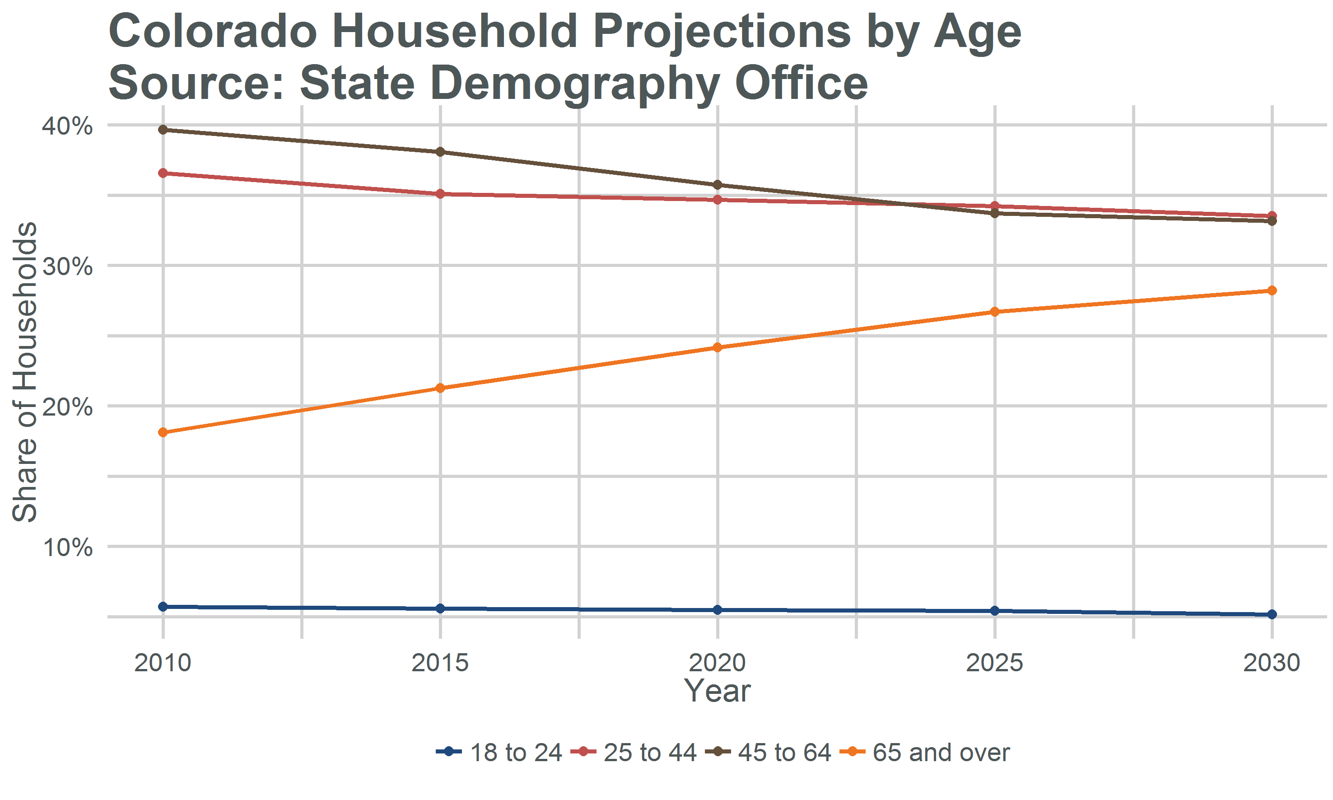

Slide 17
Thank You
State Demography Office
Department of Local Affairs
Rob Kemp
robert.kemp@state.co.us
303-864-7755
www.colorado.gov/demography

Slide 18
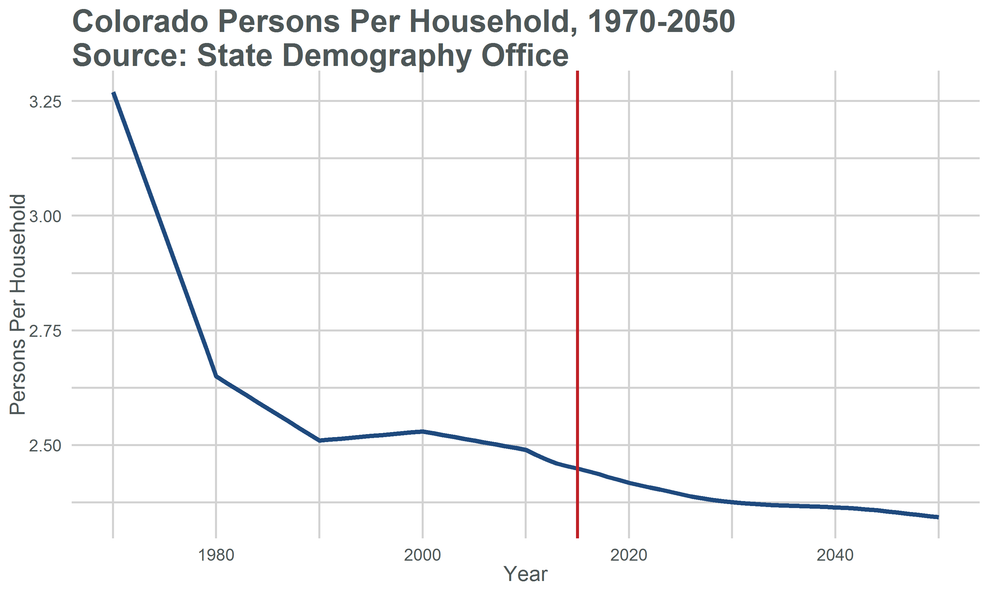

Slide 19
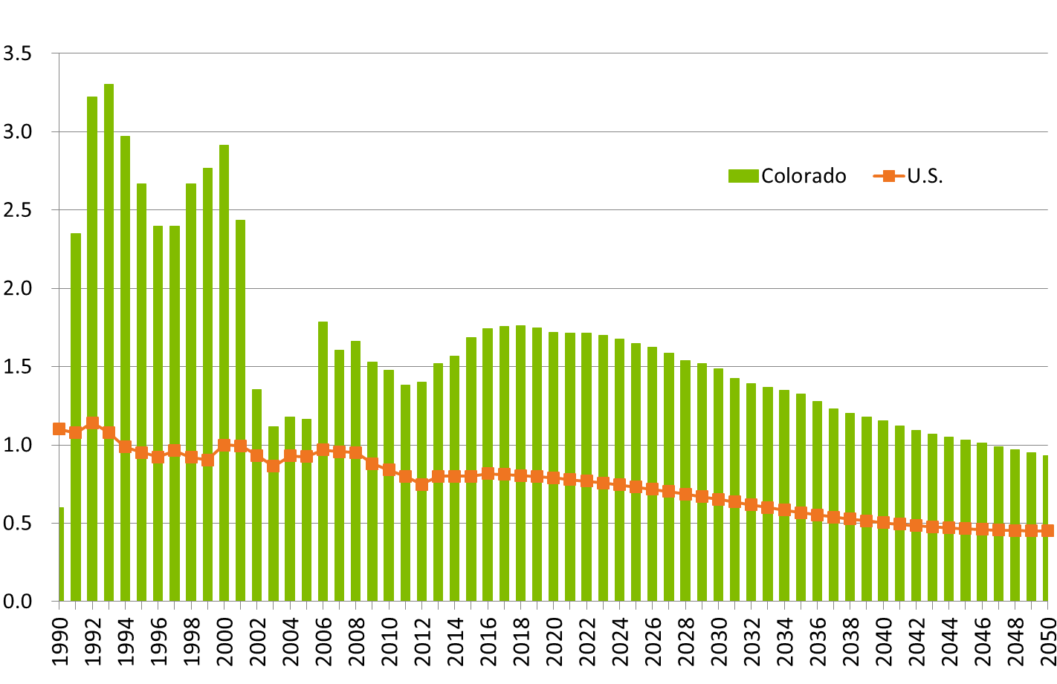
Colorado and U.S. Growth Rates

Slide 20
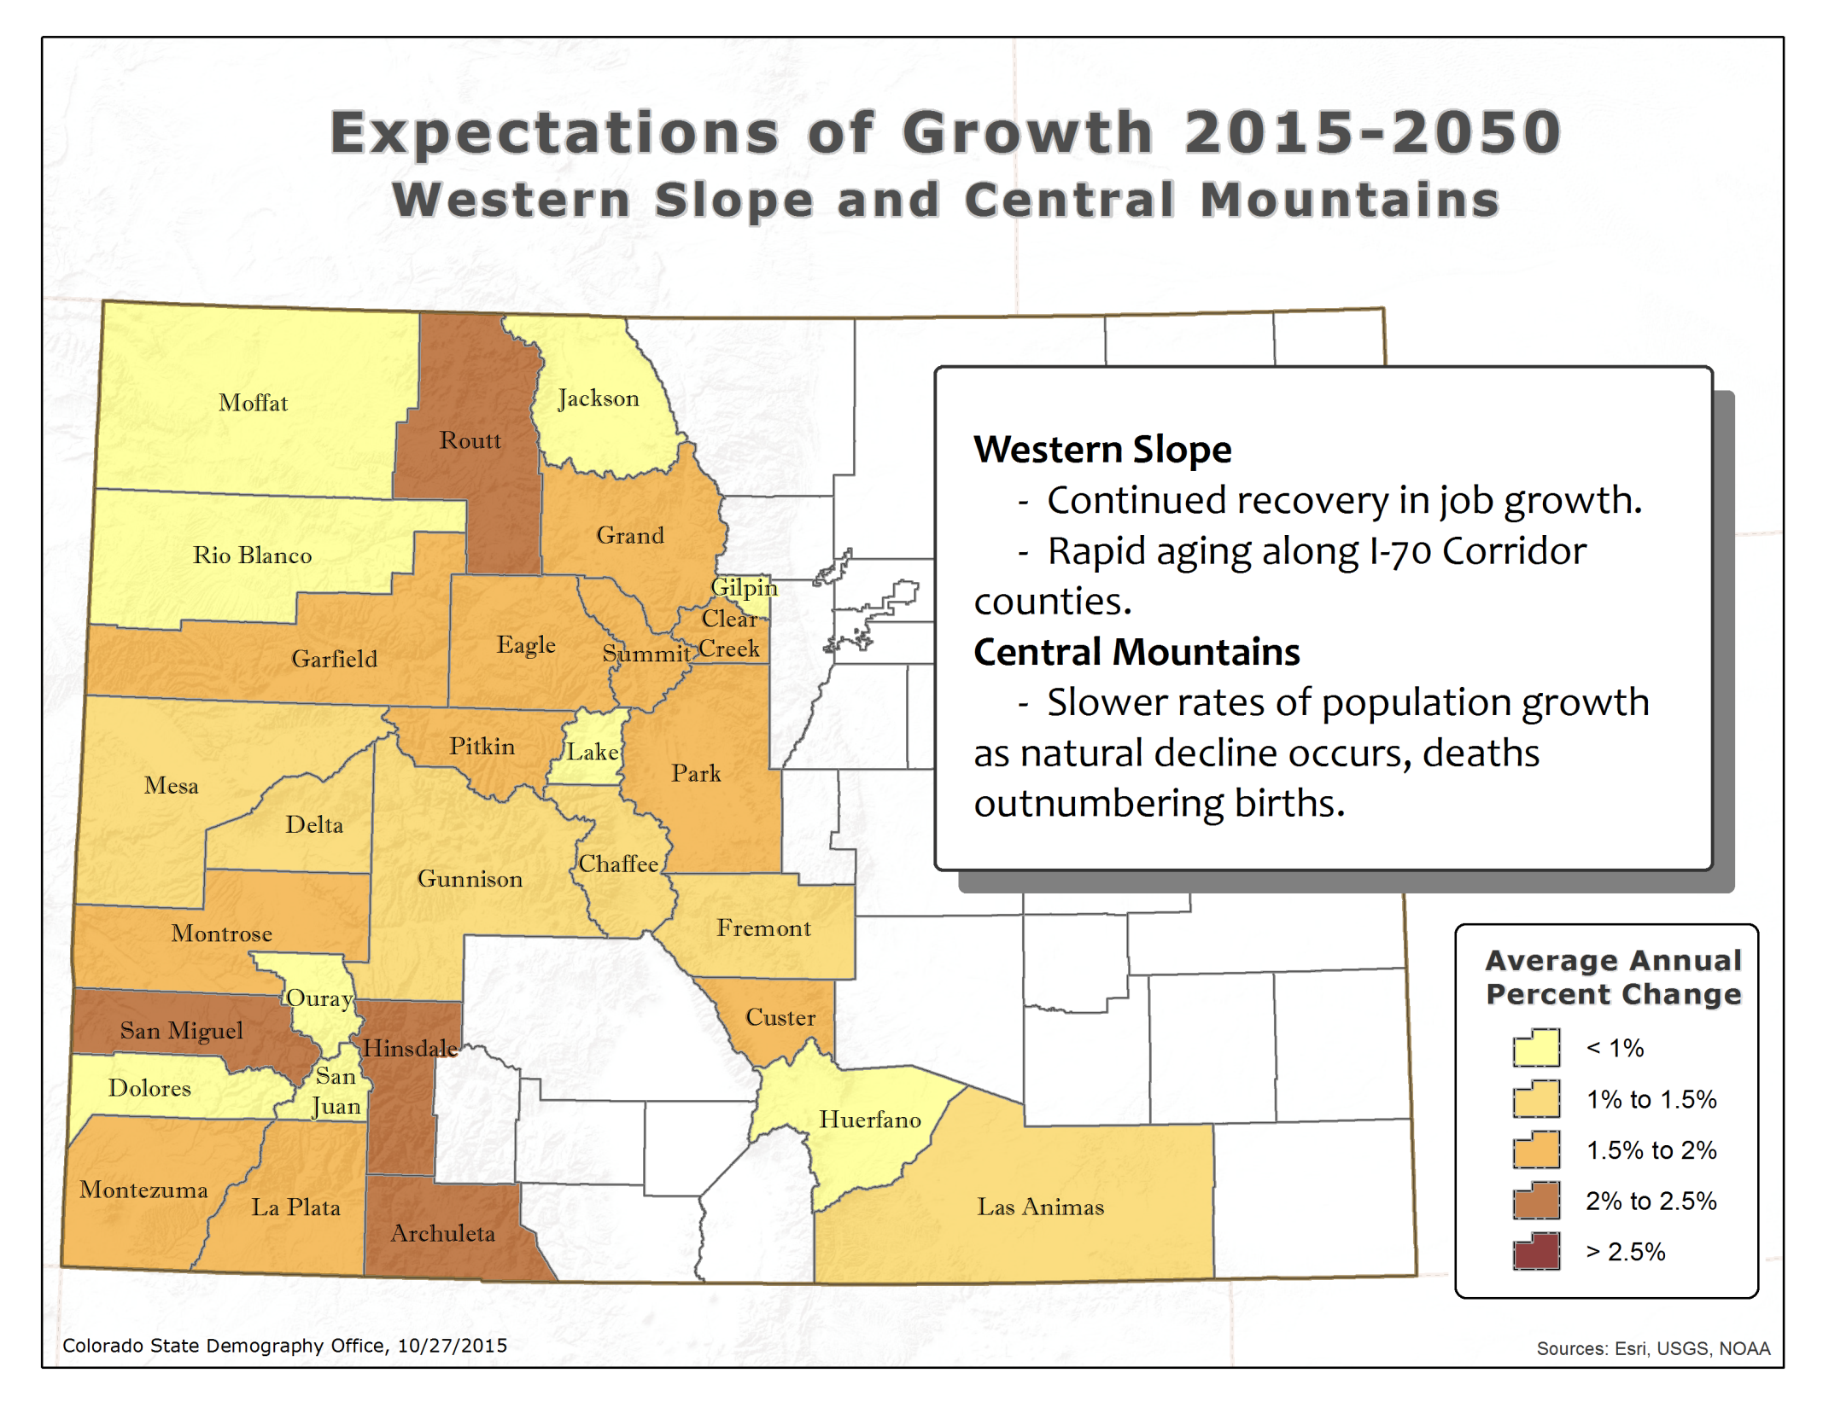

Slide 21
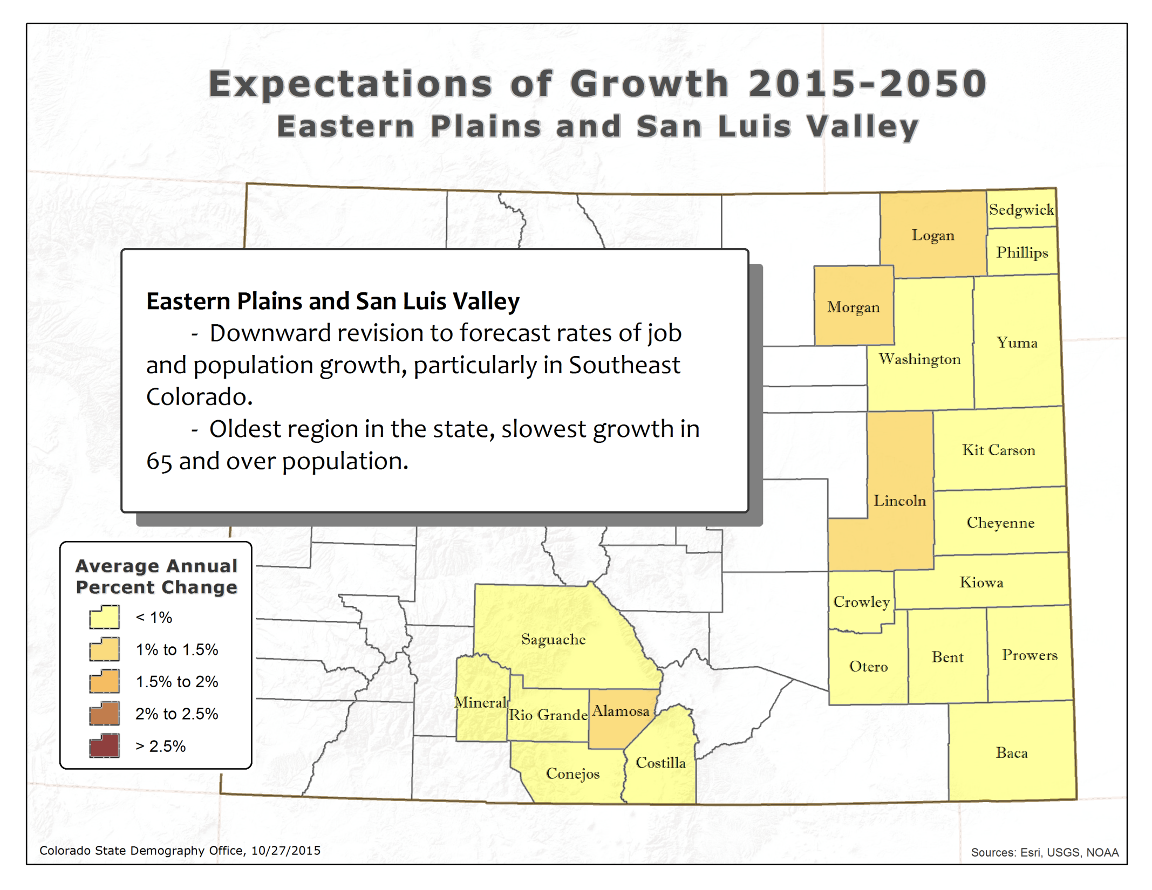

Slide 22
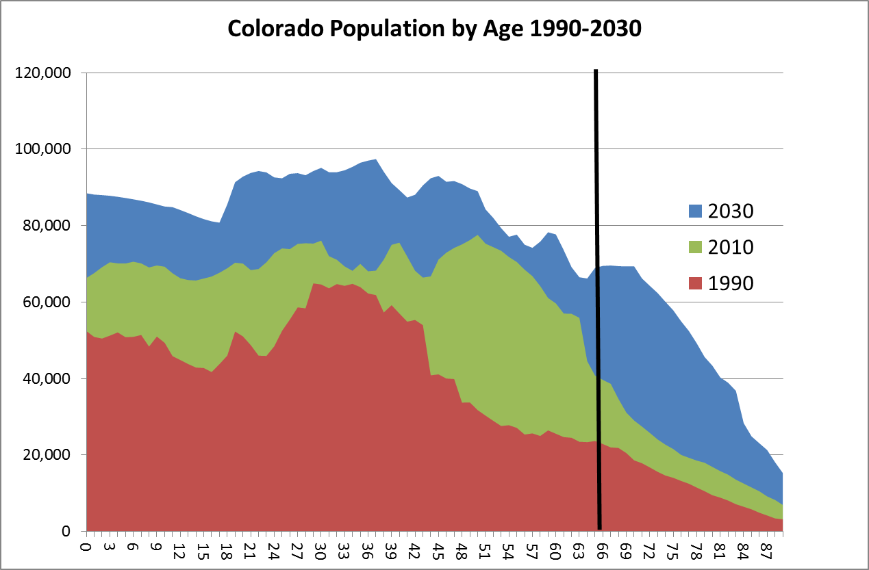
Growth in young adults due to migration

Slide 23
Demographic
Dividend

Slide 24
Aging

Slide 25
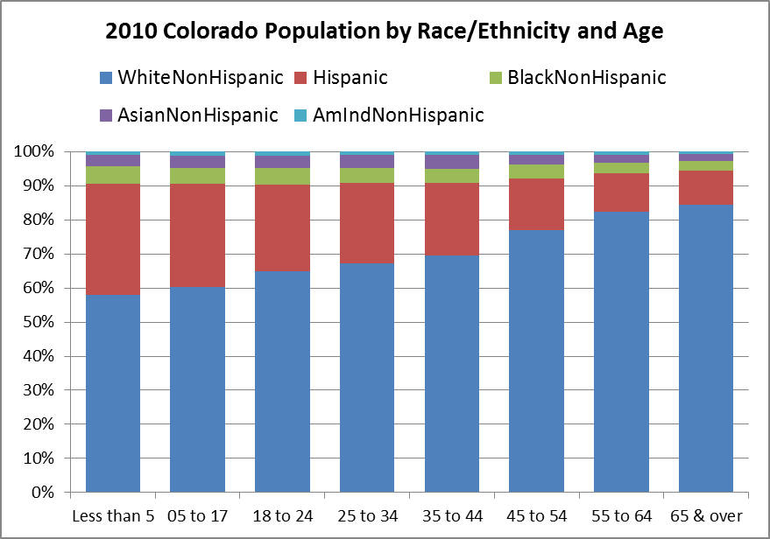
Source: U.S. Census Bureau
Notes:
This makes it look like aging Hispanics may not be a big deal but between 2000 and 2010 Hispanic 65+ increased by 56% compared to the entire population which increased by 32% Forecast to increase by 97%

Slide 26
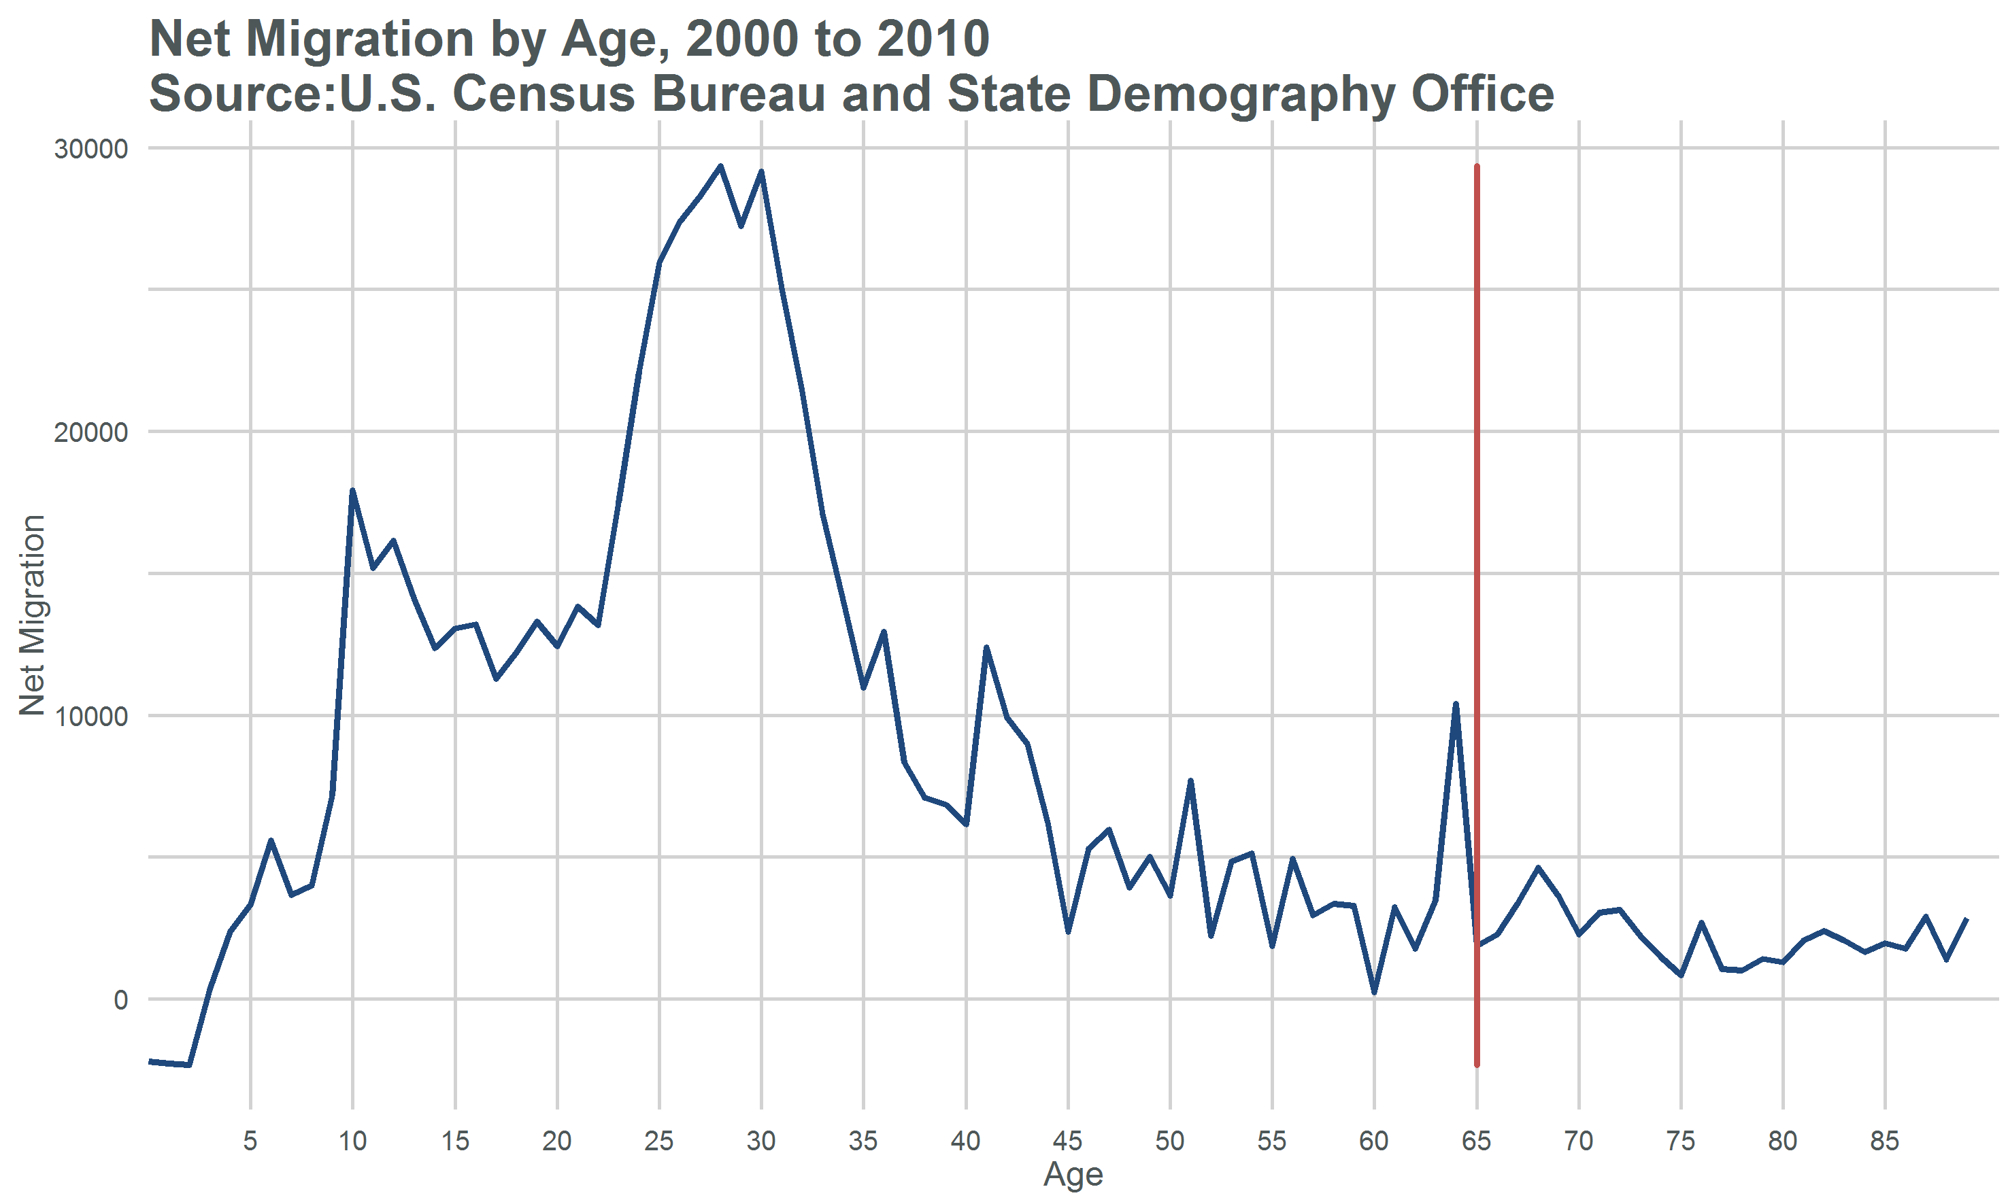
Notes:
Who are the movers?

Slide 27
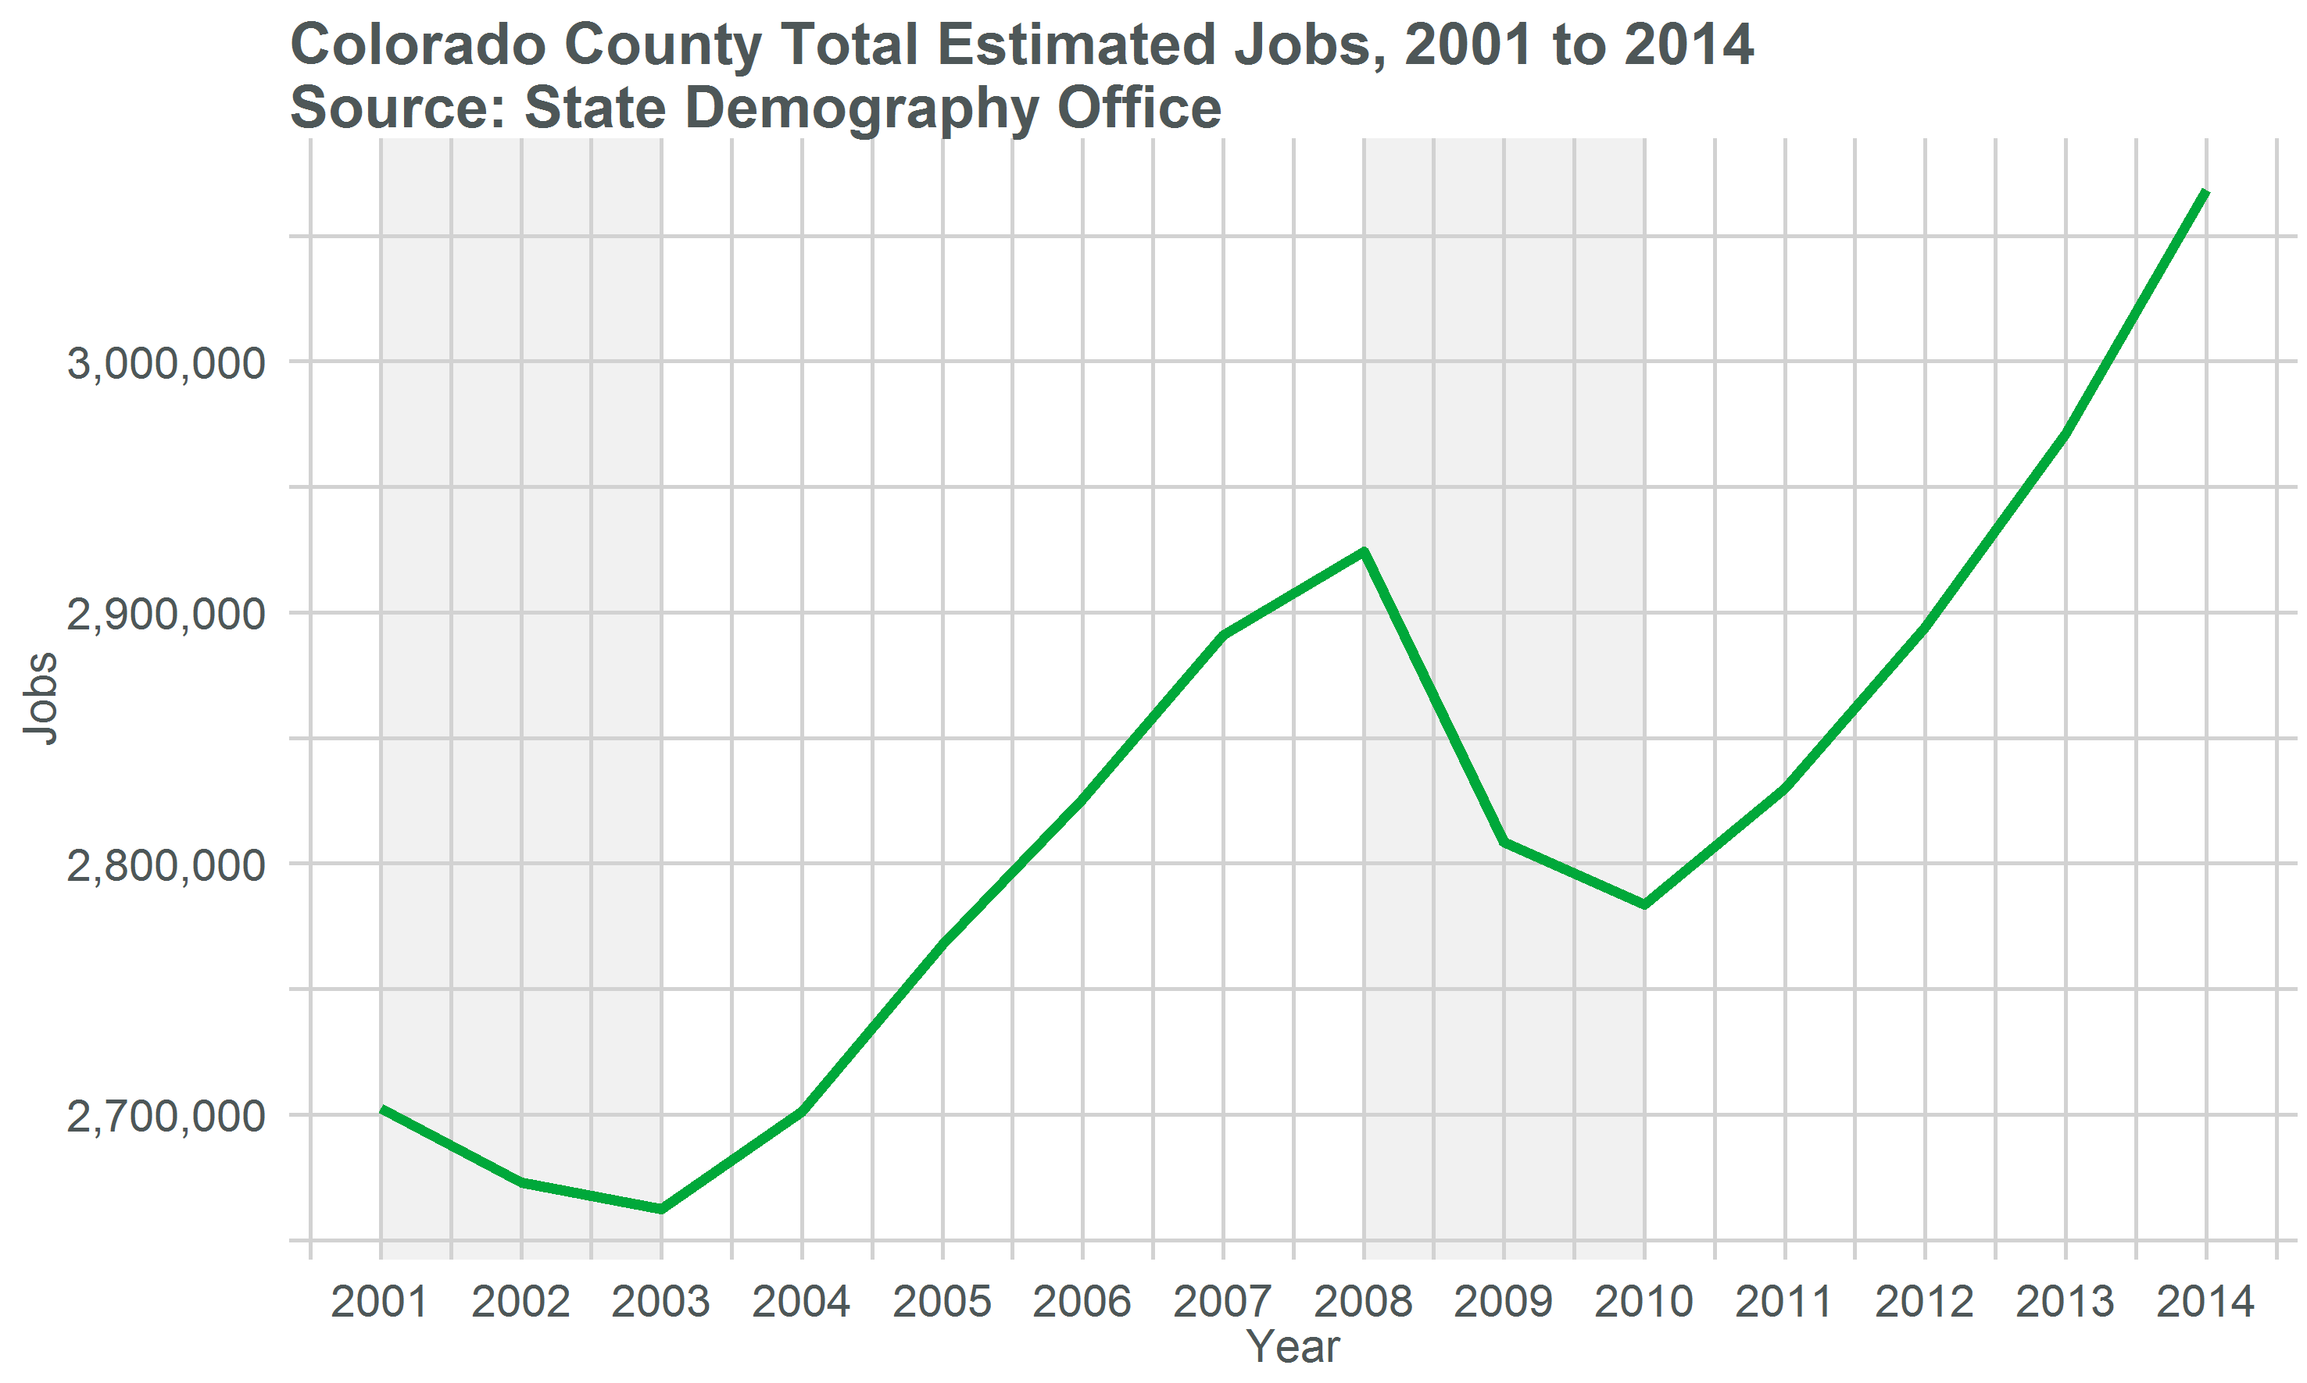
Make Font Bigger
State Demography Office

Slide 28
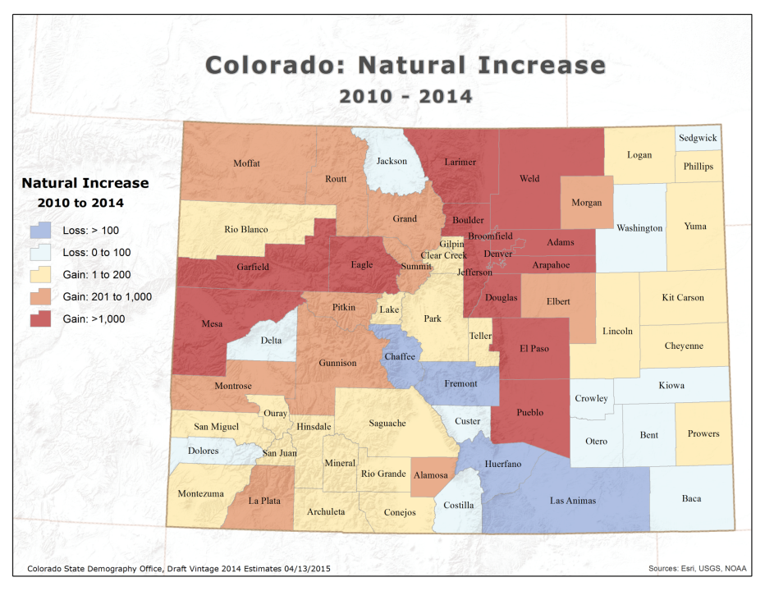
Notes:
15 counties negative natural increase

Slide 29
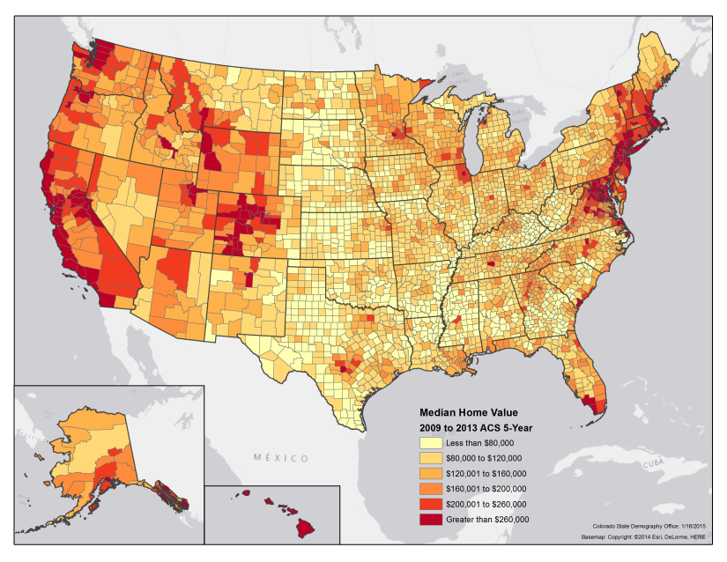
Median Home Value

Slide 30
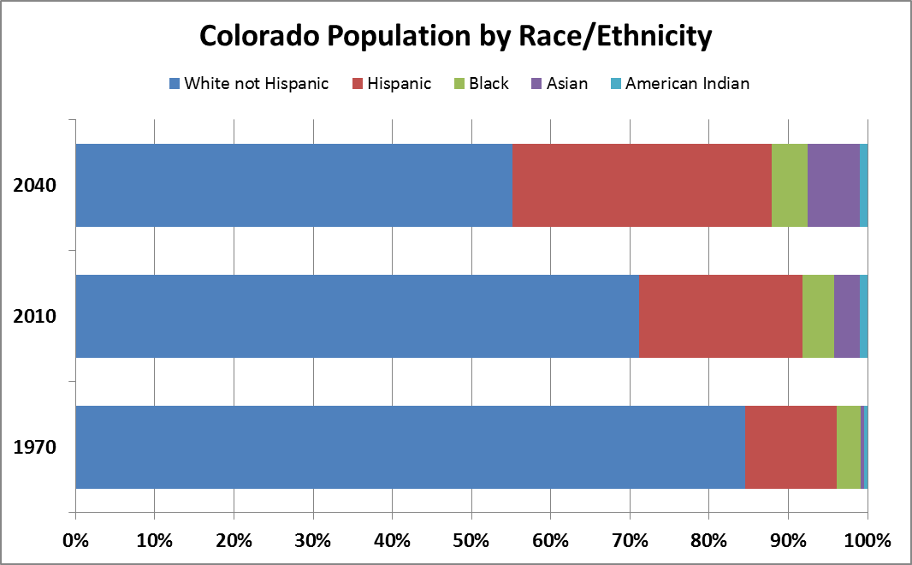

Slide 31
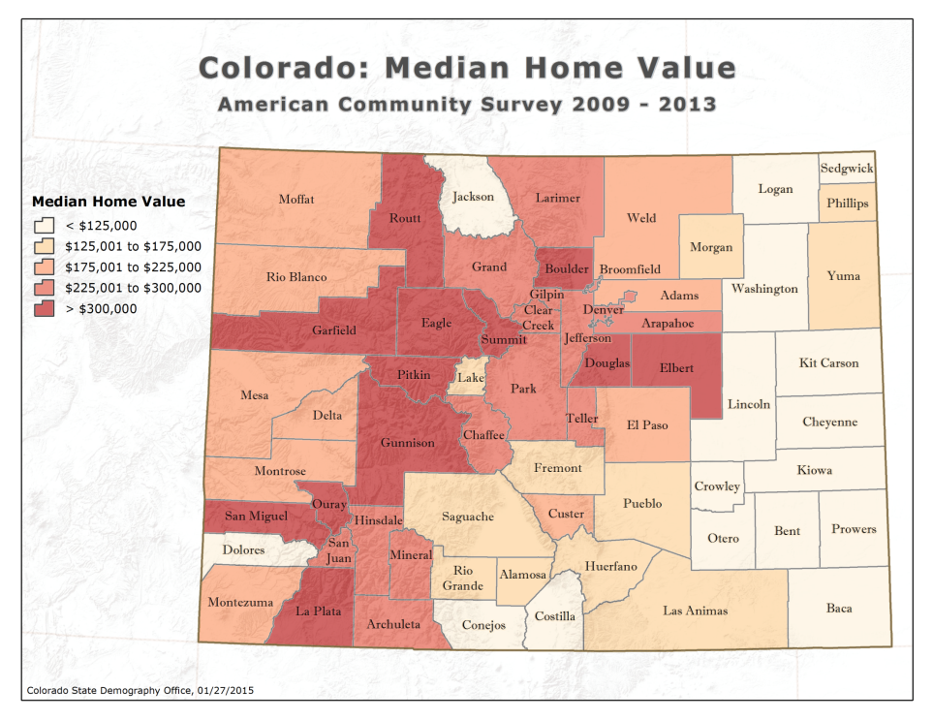

Slide 32
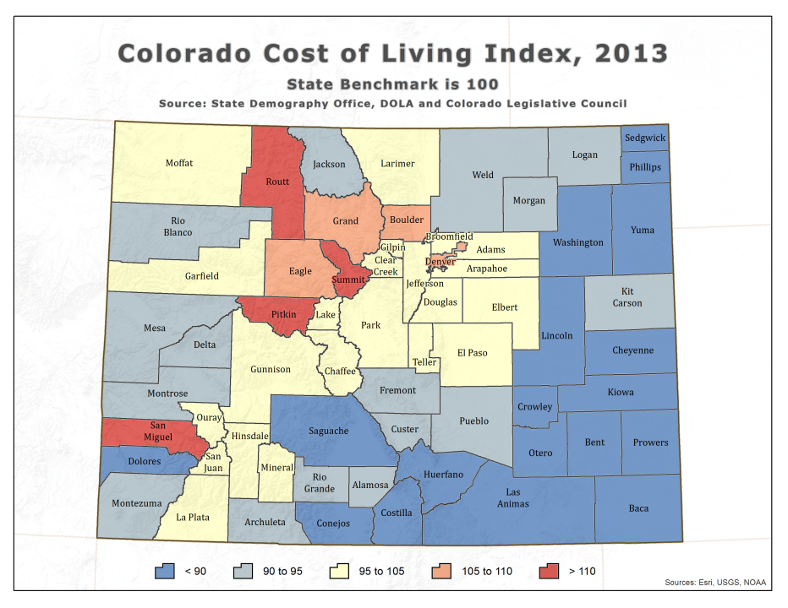

Slide 33
Household Income….its future is demographically challenged.
Age distributions – “End of “Demographic Dividend”
Occupational Mix – high and low service
More race/ethnicity diverse especially at young end but achievement gap is growing as well.
Household type and size – single and smaller.
Youth un and under employment - Long term permanent impacts on earnings.
State Demography Office

